Slide 2
nucleotide /ˈnjuːklɪətaɪd/核苷酸
deoxyribose /diːˌɒksɪˈraɪbəʊs/脱氧核糖
ribose /ˈraɪbəʊz/ 核糖
adenine (A) /ˈædənɪn/腺嘌呤
guanine (G) /ˈɡwɑːniːn/ 鸟嘌呤
purine /ˈpjʊəriːn/嘌呤
thymine (T) /ˈθaɪmiːn/ 胸腺嘧啶
cytosine (C) /ˈsaɪtoʊˌsin/胞嘧啶；
uracil (U) /ˈjʊərəsɪl/ 尿嘧啶
pyrimidine /ˌpaɪˈrɪmɪˌdiːn/嘧啶
Semi-conservative replication /kənˈsɜːrvətɪv/ /ˌreplɪˈkeɪʃn/半保留复制
transcription /trænˈskrɪpʃn/转录
translation /trænzˈleɪʃn/翻译
codon/ˈkəʊdɒn/ 密码子
anticodon/ˌæntɪˈkəʊdɒn/ 反密码子

Slide 3
primase /ˈpraɪmeɪs/引发酶
DNA polymerase DNA聚合酶
DNA ligase /ˈlaɪˌɡeɪs/ DNA连接酶
leading strand 前导链
lagging strand /ˈlæɡɪŋ/ 后随链
okazaki fragments /'ɔ:ka:'za:ki:/ 冈崎片段
allele /əˈliːl/ 等位基因
substitution /ˌsʌbstɪˈtjuːʃ(ə)n/替换
deletion /dɪˈliːʃn/ 缺失
insertion /ɪnˈsɜːʃn/重复
Transfer RNA （tRNA）转移核糖核酸
Messenger RNA9(mRNA) 信使核糖核酸
Notes:
triplet code /ˈtrɪplət/三联体密码子就是codon
密码子（codon）是指信使RNA分子中每相邻的三个核苷酸编成一组，在蛋白质合成时，代表某一种氨基酸的规律
核酸是脱氧核糖核酸（DNA）和核糖核酸（RNA）的总称，是由许多核苷酸单体聚合成的生物大分子化合物
核酸由核苷酸组成，而核苷酸单体由五碳糖、磷酸基和含氮碱基组成

Slide 4
Notes:
Teacher notes
In ‘Slide Show’ mode, click the name of a section to jump straight to that slide.

Slide 5
(i) know the basic structure of mononucleotides and the structures of DNA and RNA
(ii) know the formation of the DNA double helix
(iiii) understand the process of DNA replication, including the role of DNA polymerase (iv) understand how Meselson and Stahl’s classic experiment provided new data that supported the accepted theory of replication of DNA and refuted competing theories

Slide 6

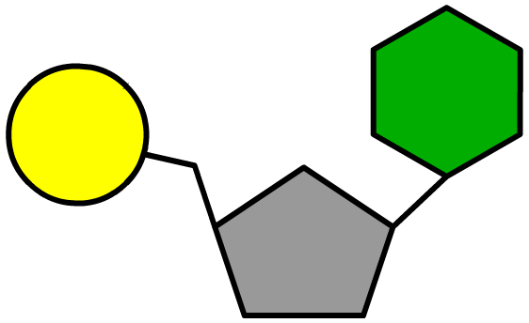
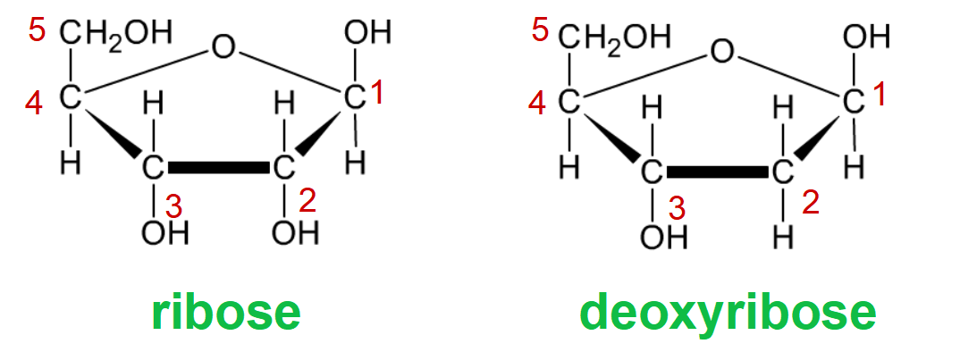

Introduction to nucleotides
Nucleotides are nitrogen-containing organic substances that form the basis of the nucleic acids DNA and RNA.
All nucleotides contain the following three groups:
a phosphate group
a nitrogen-containing base
a pentose sugar
In DNA the sugar is deoxyribose, whereas in RNA the sugar is ribose.
Notes:
Teacher notes
Some nucleotides, such as ATP, contain more than one phosphate group.
A purine base is shown in the diagram – students should not confuse this with the pentose sugar.

Slide 7
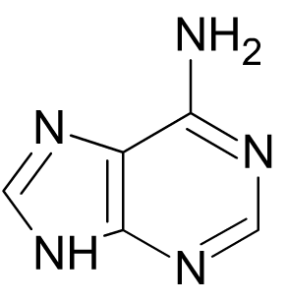
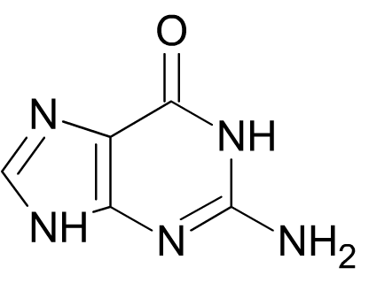
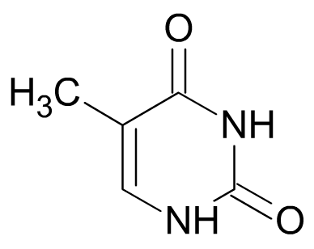
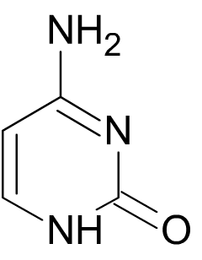
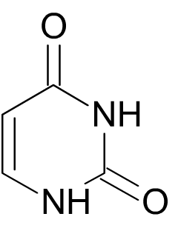
Bases
There are five bases, split into two types:
adenine (A) and guanine (G) are purine bases
Larger, double-ringed molecules
A
G
thymine (T), cytosine (C) and uracil (U) are pyrimidine bases.
Smaller, single-ringed molecules
T
C
U
DNA contains A, G, T and C, whereas RNA contains A, G, U and C.
Notes:
Teacher notes
Note that carbons have not been included in these diagrams for simplicity.

Slide 8

Identifying bases

Slide 9
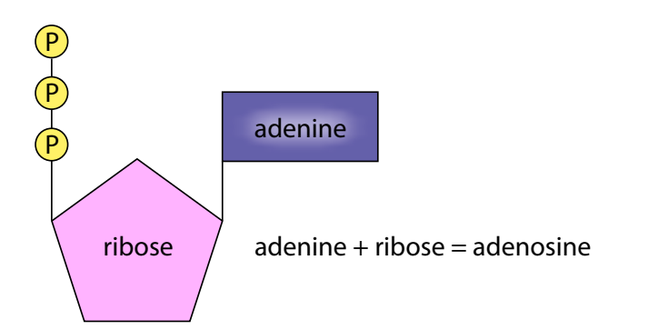
The structure of ATP
ATP (adenosine triphosphate) is not part of DNA or RNA, but acts as energy carrier，it is a nucleotide
Structure：adenine, ribose and 3 phosphates.
Adenine（A） plus ribose forms a sugar–base called adenosine腺苷.
Adenosine can be combined with one, two or three phosphate groups to give, adenosine monophosphate (AMP), adenosine diphosphate (ADP) or adenosine triphosphate (ATP).
Notes:
ATP的合成需要大量的能量，这个反应是不能自发进行的，反方向的反应才可能自发进行。
2019版教材删除了“高能磷酸键”的说法，调整了有关叙述：由于两个相邻的磷酸基团都带负电荷而相互排斥等原因，使得这种化学键不稳定，末端磷酸基团有一种离开ATP而与其他分子结合的趋势，即具有较高的转移势能。当ATP在酶的作用下水解时，脱离下来的末端磷酸基团挟能量与其他分子结合，从而使后者发生变化,它并不是一个特殊的化学键，不是“键”本身含有高能量。\
2 ATP水解为什么会释放能量
2.1 磷酸基团之间化学键不稳定
ATP分子中有3个磷酸基团，它们都带负电荷，这些负电荷在空间上相距很近，彼此之间互相排斥，就像一个被压缩的弹簧一样，导致它们之间的化学键不稳定，促使ATP的磷酸基团易于水解。
2.2 ATP水解时释放能量大于吸收能量
ATP外侧的P—O键和水中的H—O键断裂吸收能量；同时形成ADP中的O—H键和磷酸中的P—0键，放出能量。
ATP水解反应中，反应物相对于生成物拥有较高的能量。
导致ATP容易水解和释放大量自由能的因素，归结起来主要是两个：一个是引起反应物不稳定的因素（分子内静电斥力），另一个是造成产物稳定的因素（共振稳定化）。
https://mp.weixin.qq.com/s?__biz=MzI3OTQ5Mjc4MA==&mid=2247629221&idx=2&sn=c86cd678580f07349f9dacf8cc4f8d75&chksm=eb4a5866dc3dd170993ffc56afbeb810668f4b6bfa5f92dff1c1f5efae5a3ad0d2aa3b4685b4&scene=27

Slide 10
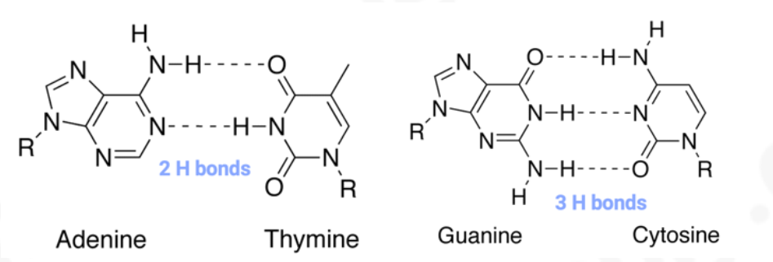
Complementary base pairing
purines combine with pyrimidines,1:1 ratio of pyrimidine:purine bases
A links with T by two hydrogen bonds; G links with C by three hydrogen bonds.
in RNA, adenine pairs with uracil（A-U）
the distance between the two backbones is therefore constant and always three rings wide
Notes:
Purines are two rings wide and pyrimidines are
one ring wide;

Slide 11
Base pairing rules
Notes:
Teacher notes
It should be clarified to students that RNA is single-stranded and so, generally, base pairing does not occur. However, in some cases, such as in tRNA, base pairing does take place.

Slide 12
Formation of nucleotides
Notes:
Teacher notes
Note that carbons have not been included in these diagrams for simplicity.
phophoester bond 写错了 是phosphodiester bond

Slide 13
5
Nitrogenous base
Phosphate group
4
1
3
2
Pentose
Deoxyribose

Slide 14
Formation of polynucleotides
Notes:
Teacher notes
Note that carbons have not been included in these diagrams for simplicity.
合成方向是5’→3’

Slide 15
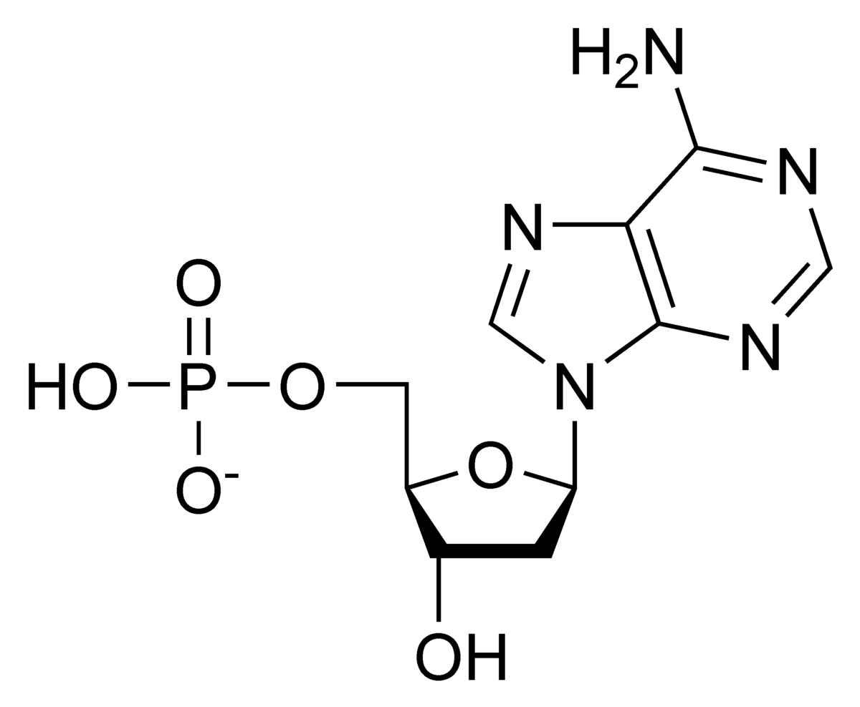
5
4
1
3
2
Phosphodiester
bond
5
4
1
3
2

Slide 16
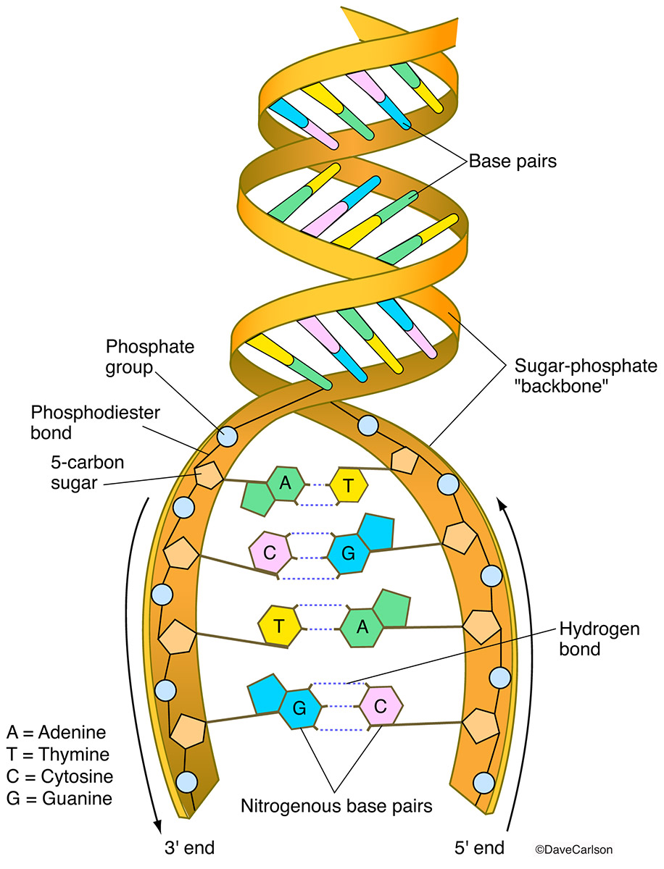
DNA double-helix structure
1.Sugar-phosphate backbone of DNA chains，linked by phosphodiester bonds
2.DNA strands are antiparalle
3.Nitrogenous bases are in the DNA strands,4 types：A，T，C，G
Complementary base pairing
4.Two DNA strands are linked by
hydrogen bonds
5.Double helix
Notes:
https://sciencing.com/subunits-dna-8435779.html
size:螺旋能缩小体积
Chemistry
DNA is a large molecule built from smaller molecules of three different chemical ingredients: sugar, phosphate and nitrogenous bases. The sugar and phosphate are located on the outer edges of the DNA molecule, with the bases arranged between them like the rungs of a ladder. Given that the fluids in our cells are water-based, this structure makes sense: sugar and phosphate are both hydrophilic, or water-loving, while the bases are hydrophobic, or water-fearing.The DNA molecule similarly twists to shrink the spaces between the hydrophobic bases on the inside. The spiral shape discourages water from flowing between them, and at the same time leaves room for the atoms of each chemical ingredient to fit without overlapping or interfering扭曲能够减少水分子进入dna分子内部，因为碱基疏水
Stacking
The bases' hydrophobic reaction isn't the only chemical event that influences DNA's twist. The nitrogenous bases that sit across from each other on DNA's two strands attract each other, but another attractive force, called the stacking force, is also at play. The stacking force attracts the bases above or below each other on the same strand. Duke University researchers have learned by synthesizing DNA molecules composed of just one base that each base exerts a different stacking force, thereby contributing to DNA's spiral shape.
Proteins
In some instances, proteins can cause sections of DNA to coil even more tightly, forming so-called supercoils. For instance, enzymes that aid in DNA replication create additional twists as they travel the DNA strand. Also, a protein called 13S condensin seems to prompt supercoils in DNA just before cell division, a 1999 University of California, Berkeley, study revealed. Scientists continue to research these proteins hoping to understand further the twists in the DNA double helix.

Slide 17
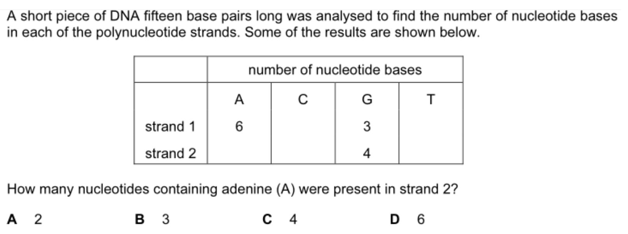
Notes:
A

Slide 18
Structure of DNA

Slide 19
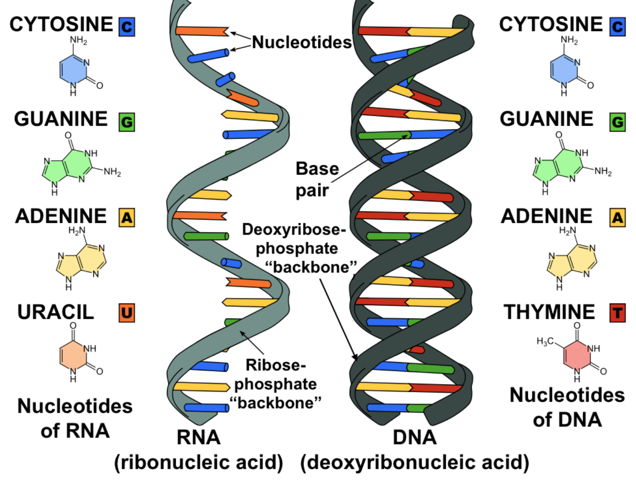
RNA structure
RNA molecule is a single polynucleotide strand
Notes:
https://zhuanlan.zhihu.com/p/22477828

Slide 20
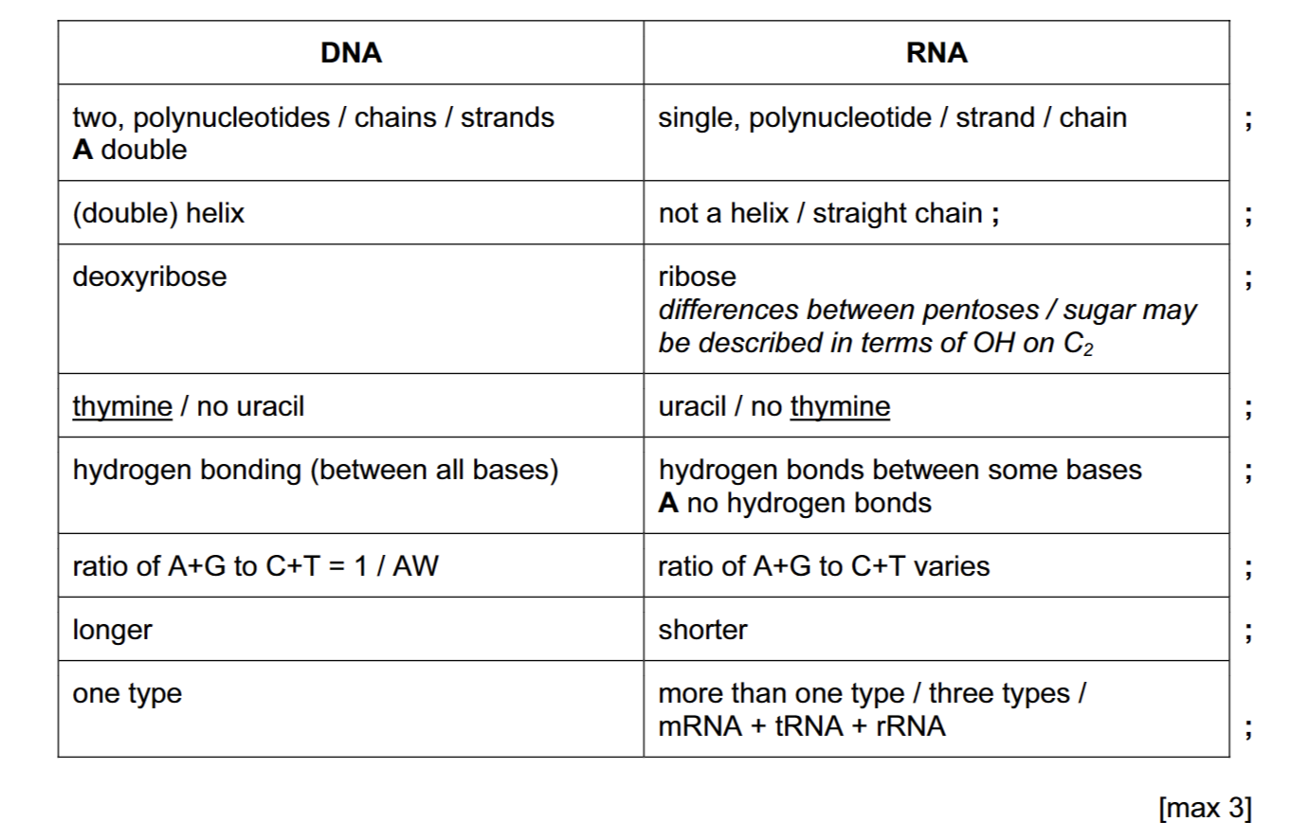

Slide 21
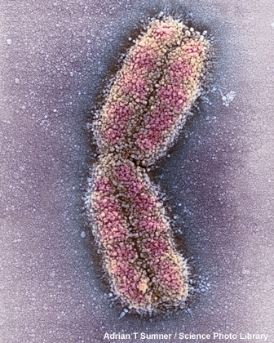
How is DNA packaged?
In eukaryotic cells, DNA is packaged as chromosomes in the nucleus.
There is around 2 m of DNA in a cell, so to fit it needs to be tightly coiled and folded.
Eukaryotic DNA is associated with proteins called histones. Together, these form chromatin – the substance from which chromosomes are made.
In prokaryotic cells, DNA is loose in the cytoplasm – there are no histones or chromosomes.
Notes:
Photo credit: Adrian T Sumner / Science Photo Library
Coloured scanning electron micrograph (SEM) of human chromosome 1. Humans have 23 pairs of chromosomes; this is the largest. It accounts for 10% of the human genome. Chromosomes, which consist of two identical chromatids joined at a centromere, are comprised of deoxyribonucleic acid (DNA) and proteins. DNA contains sections, called genes, which encode the body's genetic information. The Human Genome Project has identified the function of some of chromosome 1's genes. On chromosome 1 is a gene responsible for the eye disease glaucoma, one of the genes implicated in Alzheimer's disease and a gene for susceptibility to prostate cancer. Magnification: x16,800 when printed 10cm wide.
Teacher notes
Chromosomes can only be seen under a light microscope during cell division.
See the ‘Cell Structure’ presentation for more information about eukaryotic and prokaryotic cells.

Slide 22
Structure of eukaryotic chromosomes

Slide 23
Notes:
Teacher notes
In ‘Slide Show’ mode, click the name of a section to jump straight to that slide.

Slide 24
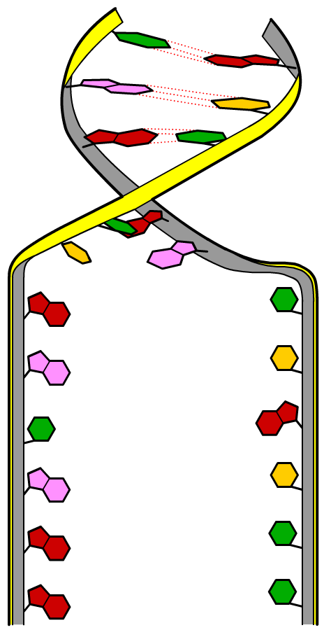
DNA replication
The discovery of DNA’s structure by Watson and Crick provided evidence that complementary base pairing was key to DNA’s ability to replicate.
Scientists proposed that DNA ‘unzipped’ as hydrogen bonds between base pairs were broken.
New polynucleotide strands could then be synthesized using the originals as a template.
Several hypotheses were proposed as to the specific mechanism by which new strands are created.

Slide 25
Mechanisms of DNA replication
Notes:
全保留 半保留 弥散复制
全保留复制是指，母链DNA分开，分别复制形成两条子链DNA，此后，两条母链DNA彼此结合，恢复原状，新和成的两条子链彼此互补结合形成一条新的双链DNA分子。
半保留复制（semiconservative replication）是 DNA复制 的模式。 亲代 DNA双链分离后的两条单链均可作为新链合成的模板，复制完成后的 子代 DNA分子的 核苷酸序列 均与亲代 DNA分子 相同，但子代DNA分子的双链一条来自亲代，另一条为新合成的链，故称为半保留复制。
在全保留 复制中，亲代的两条DNA链被完全保留在同一个子代DNA分子之中，而在弥散性复制中，来自亲代的DNA链弥散性地 分布在子代DNA的任意一条链之中。
con·ser·va·tive rep·li·ca·tion a hypothetic form of replication in which a double-stranded DNA (dsDNA) produces two daughter dsDNAs, one of which consists of the two original strands whereas the other daughter DNA consists of two newly synthesized chains.
https://www.khanacademy.org/science/biology/dna-as-the-genetic-material/dna-replication/a/mode-of-dna-replication-meselson-stahl-experiment

Slide 26

Meselson–Stahl DNA experiment
Notes:
Teacher notes
Students could be asked to illustrate and describe what the results of this experiment would have been if DNA replicates conservatively rather than semi-conservatively.
See the ‘Cell Structure’ presentation for more information about centrifugation.
先把大肠杆菌放在含有15N的培养液中培养，然后将其中的一部分转移到只含有14N的培养液中再次培养，使细菌分裂两次（14N的第一代和第二代），再与只使用14N培养液的进行比较，
15N质量大，条带沉在底下，14N培养的第一代条带位置比亲代要高，因为更轻，第二代出现了另一条更轻的条带，说明第一代的条带是15、14N的混合，更轻的是14N，与仅用14N培养的条带一致，说明dna复制后产生的新dna有15、14N，即有亲代和子代，所以是半保留复制

Slide 27
DNA replication
Notes:
整个生物圈的DNA聚合酶都只有5'-3'聚合酶的活性，而没有3'-5'聚合酶活性，就是说DNA聚合酶只能把核苷酸加入到已有链的3'端，而不能加入到5'端。而DNA的两条链反向平行，在同一个方向上，对于一条链来说是5'到3'端，另一条是3'到5'。，所以在同一个复制方向上，一条链上结合的引物在复制叉前进的方向是3'端暴露在外，所以可以连续地向这个引物的3'端加入新的核苷酸，一直延伸下去，整个过程只有一次引物合成，它就成了前导链。而对于另一条链，结合在其上的引物在复制叉的移动方向上是5'端暴露在外，无法直接进行延伸，需要不断地进行新引物的合成，然后在引物之间进行延伸，然后水解引物，填补留下的的空缺，它就成了滞后链。此外要强调一点，前导链和滞后链只对单个复制叉谈论才成立，而在实际复制着的DNA中，有两个复制叉从复制起点出发向相反方向移动，一个复制叉的前导链对于另一个复制叉而言就成了滞后链，实际上两条链经历的复制过程是相同的。所以前导链和滞后链的本质是DNA聚合酶只能在已有片段的3'端添加核苷酸，造成一条链在两个末端复制速度不相等，而DNA双螺旋又是反向平行，一条新链复制快的那头和另一条新链复制慢的那头恰好位于同一个复制叉上造成的。
primase引发酶，合成引物，引发酶（primase）：定义：合成引物（DNA合成必须要有引物）的酶；合成的过程叫做引发（priming）；引物都是10-12nt的RNA：在复制开始时须有一段RNA作为引物，这段引物在合成后并不与模板分离，而是以氢键与模板结合。这种引物即由一种独特的RNA聚合酶引发酶所合成。在大肠杆菌中这种酶是一条单链，分子量60 000，每个细胞中有50～100个分子。它们是由dnaG基因所编码的。该酶单独存在时是相当不活泼的，只有与有关蛋白质结合成一个复合物时才有活性
)DNA复制的一般过程：
DNA双螺旋是由两条方向相反的单链组成，复制开始时，双链打开，形成一个复制叉(replicative fork,从打开的起点向一个方向形成)或一个复制泡(replicative bubble，从打开的起点向两个方向形成。)两条单链分别做模板。各自合成一条新的DNA链。由于DNA一条链的走向是5′→3′方向，另一条链的走向是3′→5′方向，但生物体内DNA聚合酶只能催化DNA从5′→3′的方向合成。那么，两条方向不同的链怎样才能做模板呢?这个问题由日本学者岗崎先生解决。
原来，在以3′→5′方向的母链为模板时，复制合成出一条5′→3′方向的前导链(leadingstrand)，前导链的前进方向与复制叉打开方向是一致的，因此前导链的合成是连续进行的，而另一条母链DNA是5′→3′方向，它作为模板时，复制合成许多条5′→3′方向的短链，叫做随从链(lagging strand)，随从链的前进方向是与复制叉的打开方向相反的。随从链只能先以片段的形式合成，这些片段就叫做岗崎片段(Okazaki fragments)，原核生物岗崎片段含有1000-2000核苷酸，真核生物一般100?00核苷酸。最后再将多个岗崎片段连接成一条完整的链。由于前导链的合成是连续进行的，而随从链的合成是不连续进行的，所以从总体上看DNA的复制是半不连续复制(图16-4)。
http://yaoli.henu.edu.cn/info/1121/1282.htm

Slide 28
Semi-conservative replication of DNA
The DNA separates into two strands, and each strand acts as a template.
Each new DNA molecule consists of one old strand and a complementary new strand.
The DNA double helix unwinds and ‘unzips’ as the hydrogen bonds between the bases break by DNA helicase.
the free nucleotides that pair up by complementary base pairing on each of the old DNA
DNA polymerase links adjacent nucleotides to each other by catalysing phosphodiester bonds.
DNA ligase links the okazaki fragments together
Hydrogen bonds form within the structure, allowing it to coil up into a double helix

Slide 29
DNA replication enzymes

Slide 30
DNA replication

Slide 31
Notes:
Teacher notes
In ‘Slide Show’ mode, click the name of a section to jump straight to that slide.

Slide 32
The genetic code: timeline

Slide 33
What is the genetic code?
Gene: a length of DNA that codes for a particular polypeptide or protein
Codon: A sequence of 3 bases in DNA or mRNA.
one gene
thousands more bases in gene (not shown)
All polypeptides are made from amino acids, so the sequence of bases in a gene must code for amino acids.
Notes:
Teacher notes
The genetic code in mitochondria and chloroplasts (which both contain their own DNA) is slightly different to genomic DNA.
The size of genes varies enormously. In humans, the average gene contains 10,000–15,000 bases (10–15 kb).
遗传密码子具有以下基本特点：
1 ）每个密码子三联体 (triplet) 决定一种氨基酸；
2) 连续性：两种密码子之间无任何核苷酸或其它成分加以分离，即密码子无逗号 ;
3) 密码子具有方向性，例如 AUC 是 Ile 的密码子， A 为 5' 端碱基， C 为 3' 端碱基。因此密码也具有方向性，即 mRNA 从 5' 端到 3' 端的核苷酸排列顺序就决定了多肽链中从 N 端到 C 端的氨基酸排列顺序 ;
4) 密码子有简并性 (degeneracy) 一种氨基酸有几个密码子，或者几个密码子代表一种氨基酸的现象称为密码子的简并性。除了 Met 和 Trp 只有一个密码子外，其它氨基酸均有二个以上密码子，例如 Arg 有 6 个密码子。
5) 共有 64 个密码子，其中 AUG 不仅是 Met 或者 fMet( 在原核细胞 ) 的密码子，也是肽链合成的起始信号，故称 AUG 为起始密码子。 UAA 、 UAG 和 UGA 为终止密码子，不代表任何氨基酸，也称为无意义密码子。
6) 密码子有通用性，即不论是病毒、原核生物还是真核生物密码子的含义都是相同的。

Slide 34
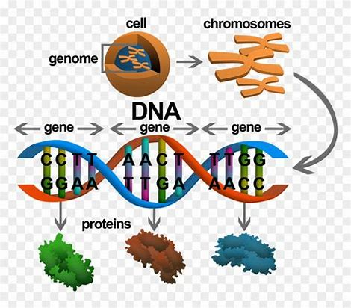

Slide 35
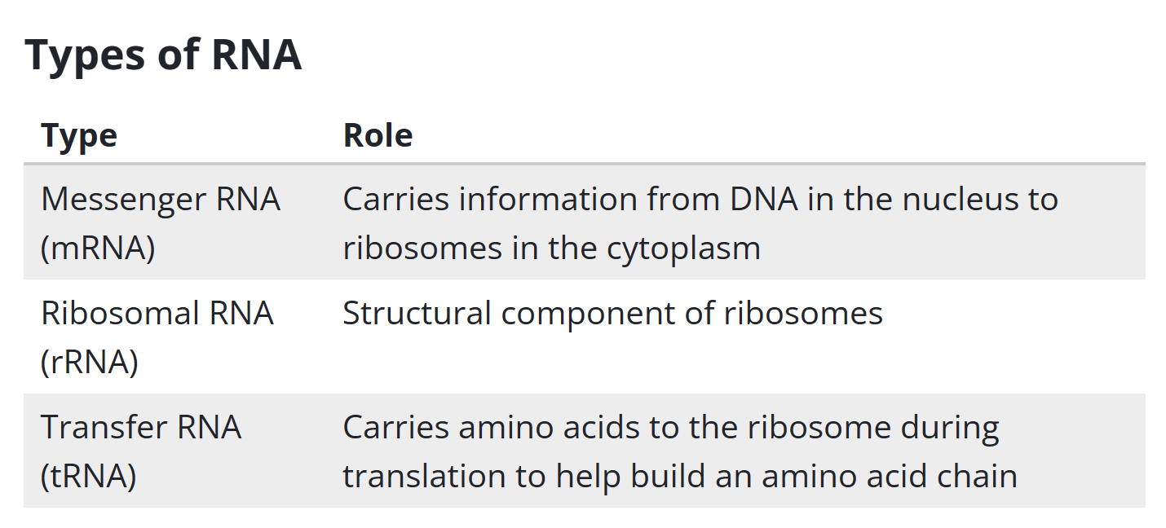

Slide 36
Features of the genetic code
• It is a three-letter code, known as a triplet code：three bases make the code for one amino acid. AUG——amino acid methionine甲硫氨酸
• The code is universal通用性:in all living things.
• The code has punctuations.
stop triplets: UAG,UAA,UGA. start codon：AUG
• The code is degenerate简并性or degeneracy.
some amino acids are coded for by more than one triplet:cysteine is coded for by ACA and ACG.
Commaless连续性：after one amino acid is coded, the second amino acid will be automatically, coded by the next three letters
The genetic code is non-overlapping不重叠: each base is only part of one triplet/codon, and each triplet/codon codes just one amino acid.
codon(mRNA)：a triplet
Notes:
The genetic code is almost universal – the same sequence of bases codes for the same amino acids in all organisms.
密码子（codon）是指信使RNA分子中每相邻的三个核苷酸编成一组，在蛋白质合成时，代表某一种氨基酸的规律

Slide 37
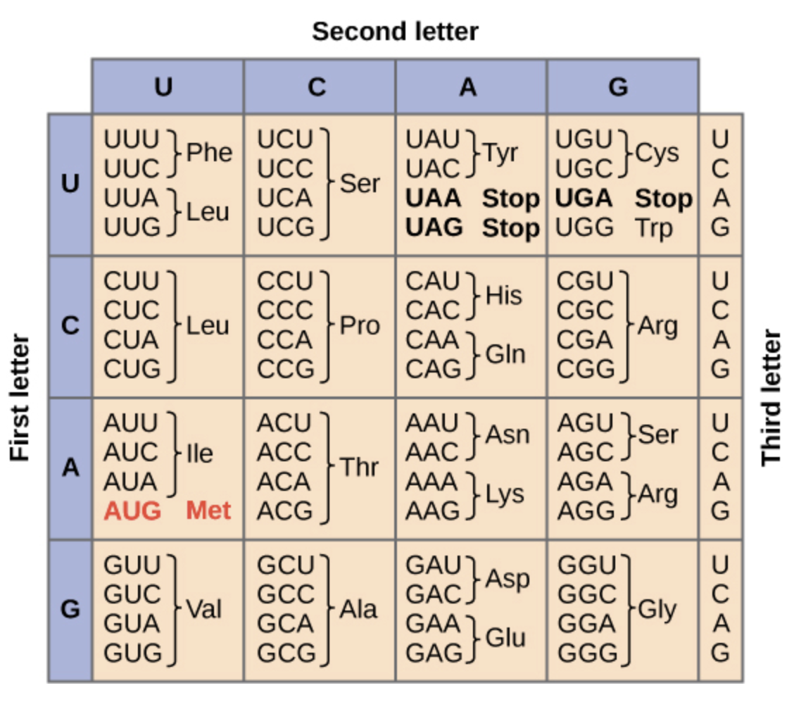
Notes:
阅读顺序也是5——3
此表是mrna的表

Slide 38
DNA：nuclear
protein synthesis in ribosome in cytoplasm
Central dogma of biology中心法则
A gene that encodes a polypeptide is expressed in two steps. In this process, information flows from DNA → RNA → protein, a directional relationship known as the central dogma of molecular biology.

Slide 39
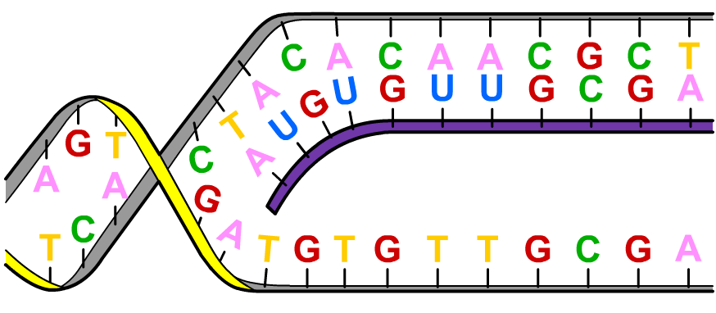
What is mRNA?
Transcription: copying the genetic information in a molecule of DNA into a complementary strand of mRNA; a single strand of the DNA is used as a template
Once a molecule of mRNA has been transcribed, it moves out of the nucleus via a nuclear pore
Like DNA, mRNA is a nucleic acid, but it differs in that:
it is single stranded
it contains ribose instead of deoxyribose
mRNA strand during transcription
it contains uracil instead of thymine.

Slide 40
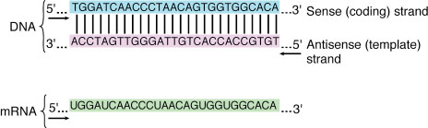
This strand of the DNA moleculeis known as the antisense反义链 or template strand 模板连(or the transcribed strand) and it is used to produce the mRNA molecule
the other strand is known as the sense strand 有义链or coding strand 编码链(or the non-template or non-transcribed strand)
Notes:
综.上所还，在某一个时候，转录只以某一-单链的某一区段
进行，用来转录mRNA的DNA链称为反义链(antisense.
strand),不用于转录的那条链则称为有义链(sensestrand)。值
得一提的是,mRNA的转录并不总是以一条DNA链为模板
的。某些基因以DNA双链中的一条为模板链，而另一些基因
则以双链中的另一条为模板链。也就是说，没有绝对的模板
链,DNA双链都可以作为模板链。因此，我们可以说DNA双
链中任一条链的碱基序列都能反映DNA双链所包含的遗传
信息。
根据碱基互补配对原则,转录出的mRNA链的碱基序列与非模板链的碱基序列一致,惟一不同的是,非模板链中的T在mRNA链中全部置换成了U。正是由于非模板链的碱基序列实际上代表了mRNA的碱基序列,只不过在mRNA中将T换成了U,因此,非模板链又被称为编码链(coding strand)和有义链(sense strand),而用来转录mRNA的DNA链被称为反义链(antisense strand)。 因此DNA双链中的有义链和反义链与转录的mRNA链的对应关系示意图如图1:
mRNA链:3'- -U ACCAUUUCCUC-- 5'
反义链:5'--ATGGTAAAGGAG--3'
有义链: 3'一 T ACC ATTTCCT C一5'

Slide 41
The genetic code

Slide 42
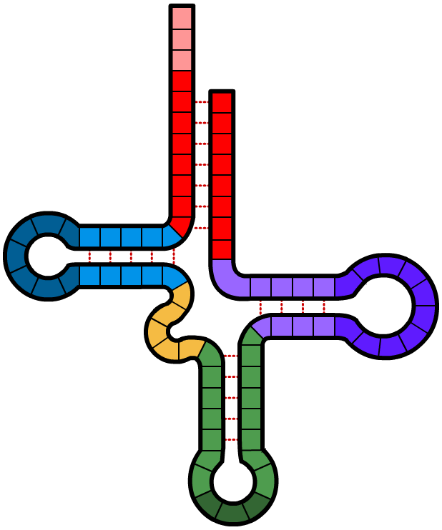
What is tRNA?
In the cytoplasm, amino acids become attached to transfer RNA (tRNA) molecules. Each tRNA is specific for one amino acid.
amino acid
attachment site
CCA
Each tRNA molecule has a sequence of three bases called an anticodon. These are complementary to codons on the mRNA molecule，Clover leaf shape
3’ end
5’ end
hydrogen bond
What is the anticodon for the codon A U G?
nucleotides
U A C
anticodon
Notes:
anticodon阅读方向：5——3 除非有特殊会标明阅读方向

Slide 43
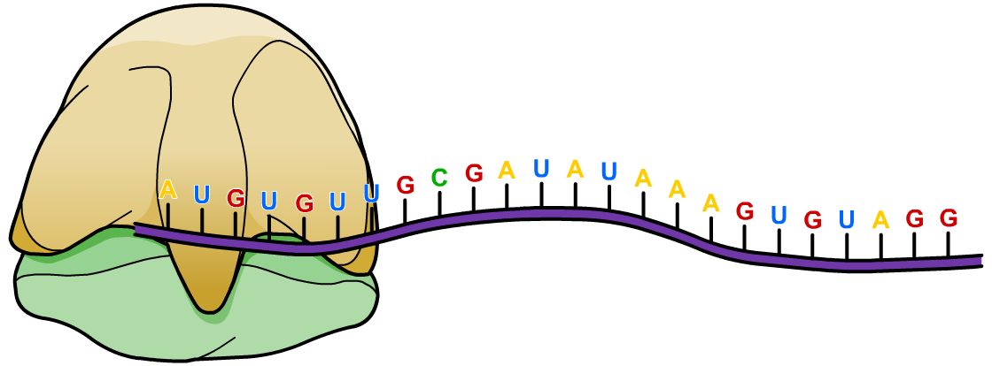
What is translation?
In the cytoplasm,a sequence of nucleotides in a molecule of mRNA is converted (translated) into a corresponding sequence of amino acids in a polypeptide chain; it takes place at ribosomes
ribosome
mRNA strand
How are the correct amino acids transported to the ribosome, and how are they linked together in the correct order?
Notes:
Teacher notes
Ribosomes are composed of about 65% ribosomal RNA (rRNA) and 35% ribosomal protein. They consist of a large and small sub-unit that only come together at the start of protein synthesis.
氨基酸是先合成好了之后再与mrna结合，所以需要trna运输氨基酸

Slide 44
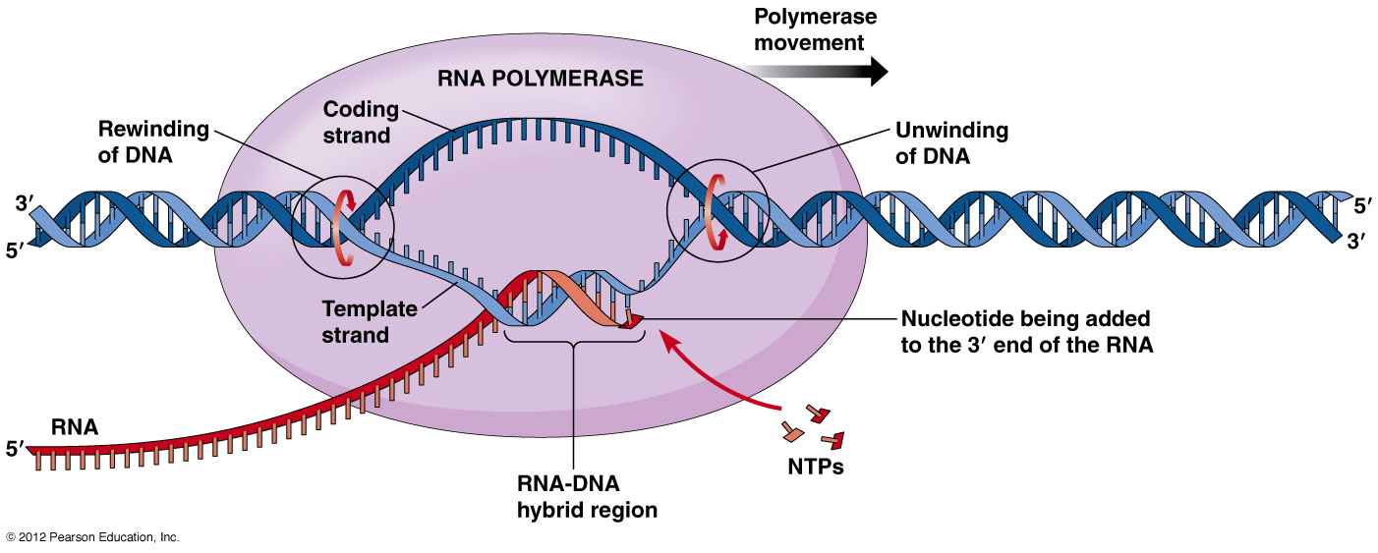
Protein synthesis——a) Transcription
Process by which enzymes use the antisense strand of DNA as a template to produce a messenger RNA (mRNA) molecule.
1) RNA polymerase binds to a region of gene to be copied
this signals DNA to unwind so bases can be read
the strand that’s read is the template/antisense strand
Notes:
聚合酶（polymerase）又称多聚酶。是专门生物催化合成脱氧核糖核酸(DNA)和核糖核酸(RNA)的一类酶的统称。1957年，美国科学家阿瑟·科恩伯格（Arthur Kornberg）发现。
(1)依赖DNA的DNA聚合酶；(2)依赖RNA的DNA聚合酶；(3)依赖DNA的RNA聚合酶；(4)依赖RNA的RNA聚合酶。前两者是DNA聚合酶，它使DNA复制链按模板顺序延长。(3)和(4)是催化RNA生物合成反应中最主要的RNA合成酶，它们以四种三磷酸核糖核苷(NTP)为底物，并需有DNA模板以及Mn2 及Mg2 的存在下，在前一个核苷酸3′-OH与下一个核苷酸的5′-P聚合形成3′，5′-磷酸二酯键，其新生链的方向也是5′→3′
RNA聚合酶催化RNA的合成，其与DNA聚合酶有许多相同的催化特点：
①以DNA为模板；
②催化核苷酸通过聚合反应合成核酸；
③聚合反应是核苷酸形成3’，5’一磷酸二酯键的反应；
④以3’→5’方向阅读模板，5’→3’方向合成核酸；
⑤按照碱基配对原则忠实转录模板序列
与DNA聚合酶不同，RNA聚合酶无须引物，它能直接在模板上合成RNA链；RNA聚合酶能够局部解开DNA的两条链，所以转录时无须将DNA双链完全解开，RNA聚合酶无校对功能

Slide 45
2) RNA polymerase reads antisense strand and generates mRNA from
5’ to 3’，phosphodiester bonds，hydrogen bonds
3) when RNA polymerase has reached the terminator sequence at the end of the gene, transcription stops，mRNA is released
- enzyme detaches from gene and DNA returns to original structure
4) STOP Condon：in DNA the stop codons are UAA, UGA, UAG
5）Once a molecule of mRNA has been transcribed, it moves out of the nucleus via a nuclear pore
Notes:
5）转录完成，离开细胞核

Slide 46
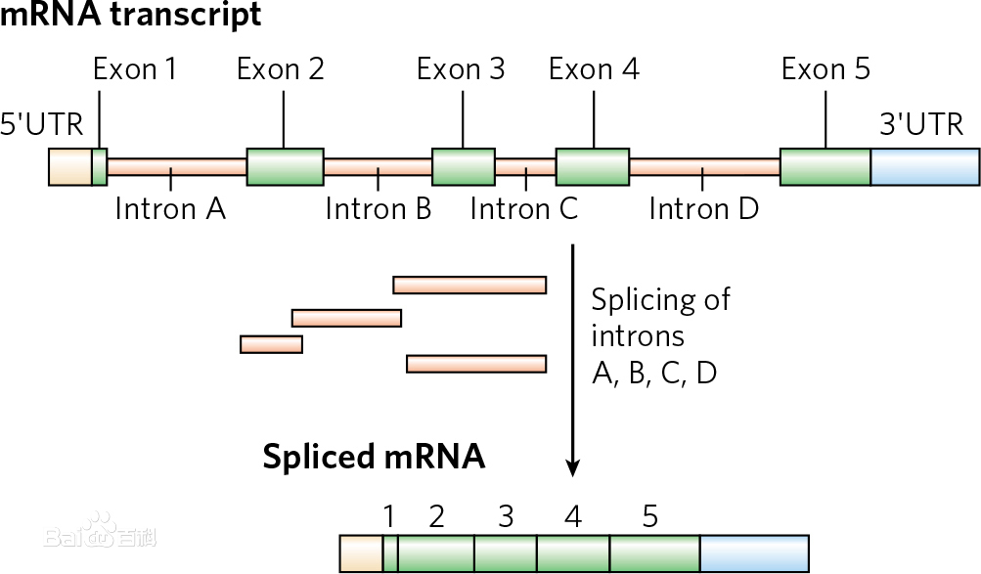
Notes:
内含子（introns）在转录后的加工中， 从最初的转录产物除去的内部的核苷酸序列。术语内含子也指编码相应RNA内含子的DNA中的区域。
大多数真核结构基因中的间插序列（intervening sequence）或不编码序列。它们可以转录，但在基因转录后，由这些间插序列转录的部分（也可用内含子这个术语表示）经加工被从初级转录本中准确除去，才产生有功能的RNA。基因的编码部分称外显子。内含子常比外显子长，且占基因的更大比例。真核基因所含内含子的数目、位置和长度不尽相同，如鸡卵清蛋白基因的外显子被7个内含子隔开，鸡卵伴清蛋白基因有17个内含子，α-珠蛋白基因有2个内含子，卵粘蛋白基因有6个内含子等。内含子（Intervening region）是一个基因中非编码DNA片段，它分开相邻的外显子。更精确的定义是：内含子是阻断基因线性表达的序列。DNA上的内含子会被转录到前体RNA中，但RNA上的内含子会在RNA离开细胞核进行转译前被剪除。在成熟mRNA被保留下来的基因部分被称为外显子。真核生物的基因含有外显子和内含子，是前者区别原核生物的特征之一。
内含子转录的mRNA与其它的成分是一样的，均由4种核糖核苷酸组成，只不过被识别后剪切掉了。内含子也不是不变的，在合成某种蛋白质或多肽时为内含子，在控制合成另一种蛋白质或多肽时可能为外显子。内含子在选择性剪接扮演重要角色，一个基因可以因此而产生多种不同的蛋白质。归根到底，是在剪接过程中同一段DNA，有时被看作外显子，有时则是内含子。
有一种特殊的内含子，被称作自剪接内含子（核酶），它可以通过自身作用被切除，来离开mRNA。
断裂基因中的编码序列。外显子（expressed region）是真核生物基因的一部分。它在剪接（Splicing）后会被保存下来，并可在蛋白质生物合成过程中被表达为蛋白质。外显子是最后出现在成熟RNA中的基因序列，又称表达序列。
既存在于最初的转录产物中，也存在于成熟的RNA分子中的核苷酸序列。术语外显子也指编码相应RNA外显子的DNA中的区域。所有的外显子一同组成了遗传信息，该信息会体现在蛋白质上。外显子虽然仅占人类基因组的1%-2%，但是在外显子上却包含了85%的已知致病突变。 [3]

Slide 47
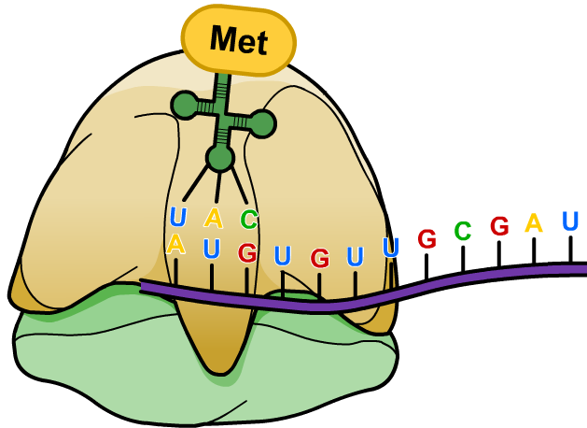
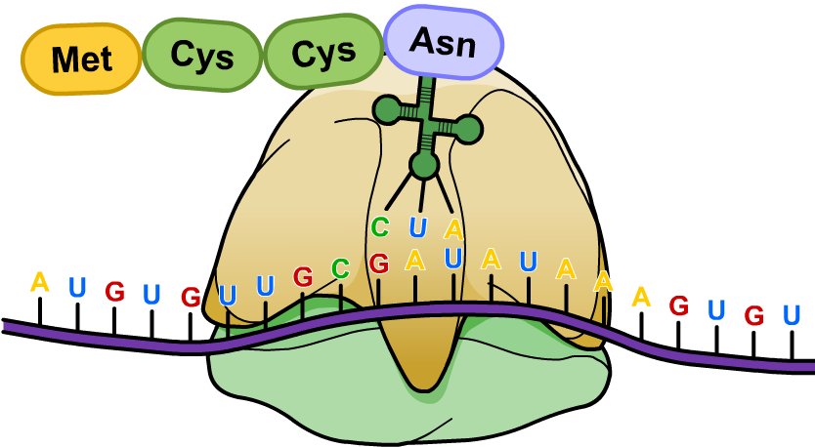
What happens during translation?
tRNA molecules attach to the ribosome, and their anticodons pair up with the appropriate codons on the mRNA.
The amino acids transported by the tRNA link together, and the tRNA molecules then return to the cytoplasm.
The ribosome moves along the mRNA, and amino acids continue to join together until all the codons have been translated and the polypeptide is complete.
Notes:
Teacher notes
Ribosomes translate mRNA at a rate of 15 amino acids per second. This can be increased by the use of polysomes – multiple ribosomes each translating a different part of the same mRNA strand.

Slide 48
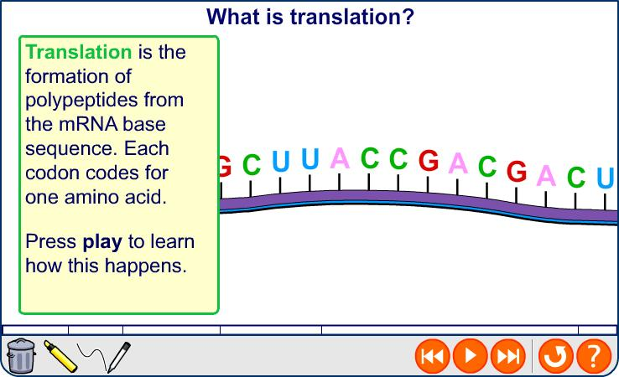
Translation
Notes:
Teacher notes
Several ribosomes can translate the polypeptide at the same time, producing many copies of a polypeptide simultaneously. Once a ribosome moves past the start codon, another ribosome can attach to the mRNA. Strings of ribosomes are called polyribosomes. In eukaryotes ribosomes are found on the rough endoplasmic reticulum.
The first codon in a gene codes for the amino acid methionine.
See the Boardworks AS Biology ‘Nucleic Acids and the Genetic Code’ presentation for more information about the genetic code

Slide 49
b) Translation
Process by which the genetic code in mRNA is read to make a protein.
1) every 3 bases (a codon) on mRNA codes for a specific anticodon which is carried by a transfer RNA (tRNA) molecule
2） each different tRNA is linked to a particular amino acid
process：
1）mRNA leaves the nucleus and binds to the ribosome
2) an initiator tRNA carriers amino acid to adheres to a START codon：AUG
3) the next tRNA enters the ribosome carrying an amino acid with it which becomes covalently bound to methionine from the initiator tRNA
Notes:
核糖体沿mRNA移位”
小亚基与mRNA结合，大亚基有两个tRNA结合位，给位（donor site）或称为肽位（peptidyl site，P位）和受位（acceptor site，A位）或称为氨基酰位（aminoacyl site），P位点供肽酰-tRNA结合，A位点供氨基酰-tRNA结合

Slide 50
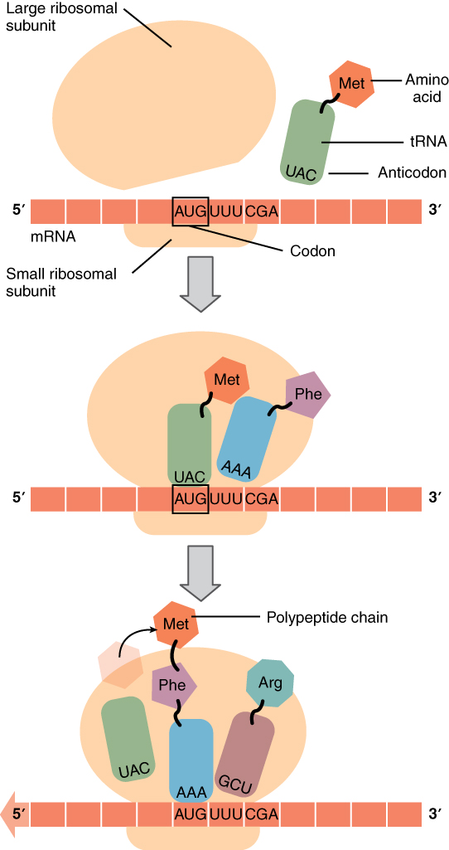

Slide 51
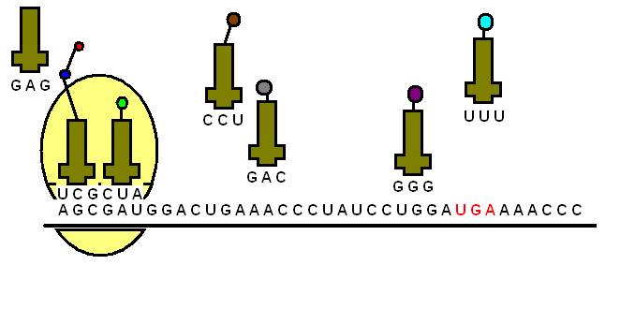
4）moving of ribosome，a new amino acid carried by new tRNA links the first two，first tRNA detaches
5） this polypeptide chain continues to grow till a STOP codon is reached

Slide 52
Protein synthesis – Translation
The protein is now formed and can be folded into it’s 3D shape.
The mRNA is released by the ribosome and can be reused.
The ribosome will also be able to start the process all over again.

Slide 53
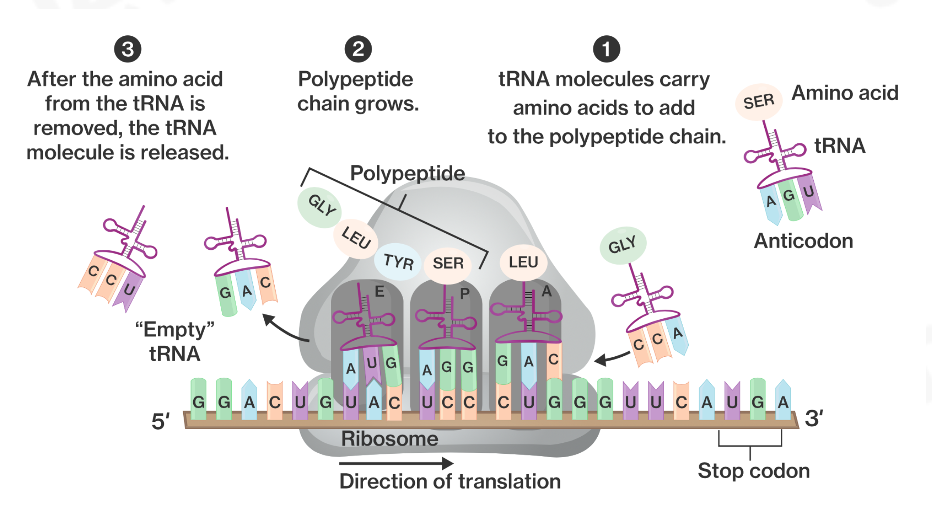
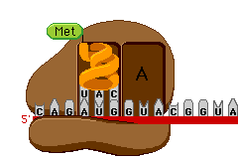
Notes:
trna已经携带了氨基酸在一旁等候，再与mrna在核糖体中结合，翻译具有方向性：方向：核糖体沿着mrna移动，方向：5——3
这个图上没有画出起始密码子、
核糖体含有三个RNA结合位点：即A、P和E位点。A位点结合氨酰基-tRNA或终止释放因子 [9] ；P-位点结合肽基-tRNA（与tRNA结合的tRNA）多肽链；E位点（出口）结合游离tRNA

Slide 54
Stages of protein synthesis

Slide 55
From DNA to amino acids
Notes:
Teacher notes
The students should be reminded that, when identifying the amino acids, it is the bases in mRNA codons – and not the tRNA anticodons – that should be used.
密码子指的是mRNA分子上决定蛋白质氨基酸顺序的核苷酸序列，是由三个碱基组合在一起的编码方式。 所以生物密码子表对应的是mRNA，tRNA上的三个核苷酸顺序被称为反密码子。 如下图所示，左边mRNA上的核苷酸顺序是AGU，对应的反密码子是UCA，根据密码子AGU在密码子表中找到的对应氨基酸为Ser。

Slide 56
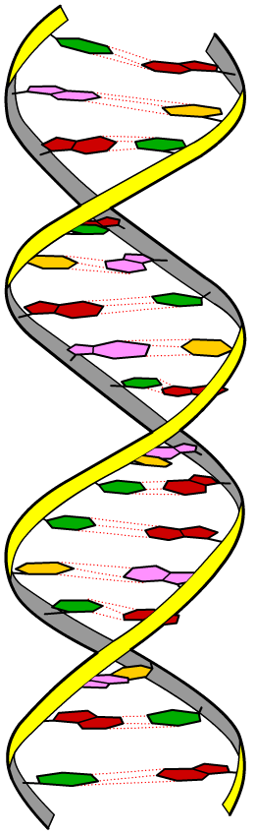
Genetic mutations
A mutation is a change in the amount or structure of DNA. There are two types of mutation:
A gene or point mutation – a change in the base sequence of a gene, which can cause a change in the polypeptide chain. It is caused by errors that occur during DNA replication.
A chromosome mutation – a change in the number or structure of the chromosomes. It is caused by errors that occur during cell division.

Slide 57
Errors in replication: gene mutations
Notes:
Teacher notes
A transition is a type of substitution mutation where one pyrimidine is swapped for a different pyrimidine (e.g. T substituted by C), or one purine is swapped for a different purine (e.g. G substituted by A). This type of mutation is far more common than transversion, where a pyrimidine is swapped by a purine, or vice versa.
If a substitution occurs in a region of the gene that is involved in coding (certain part of a gene are non-coding regions), it may be further classified as one of three mutations:
silent mutation – the triplet codes for the same amino acid
missense mutation – the triplet codes for a different amino acid (if this is chemically similar it may have no noticeable effect, so is a ‘neutral mutation’)
nonsense mutation – the triple codes for a stop codon
Insertion and deletion mutations are examples of frameshift mutations – they alter the ‘reading frame’ of the gene downstream of the mutation, which will affect the structure of the protein. The closer to the beginning of the gene the mutation occurred, the more altered the protein will be.
See the ‘Cell Division’ presentation for more information about chromosome mutations.
Gene mutation – a change in the sequence of
nucleotides that may result in an altered polypeptide
- types of gene mutations: substitution, deletion删除,
insertion插入, inversion, frameshift移码

Slide 58
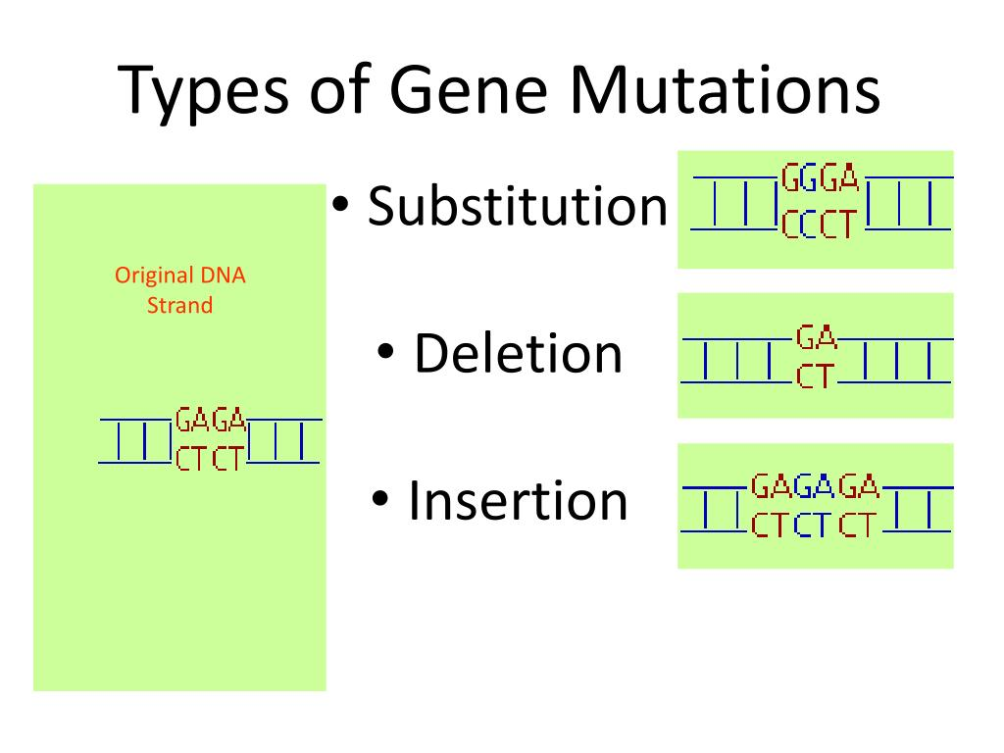
substitution： one base in a gene is substituted for another
deletion： a base is completely lost
insertion： an extra base is added into a gene, which may be a repeat or a different base

Slide 59
Chromosome mutations
Notes:
Boardworks AS Biology
Title of presentation
Teacher notes
See the ‘Nucleic Acids and the Genetic Code’ presentation for more information about DNA replication.

Slide 60
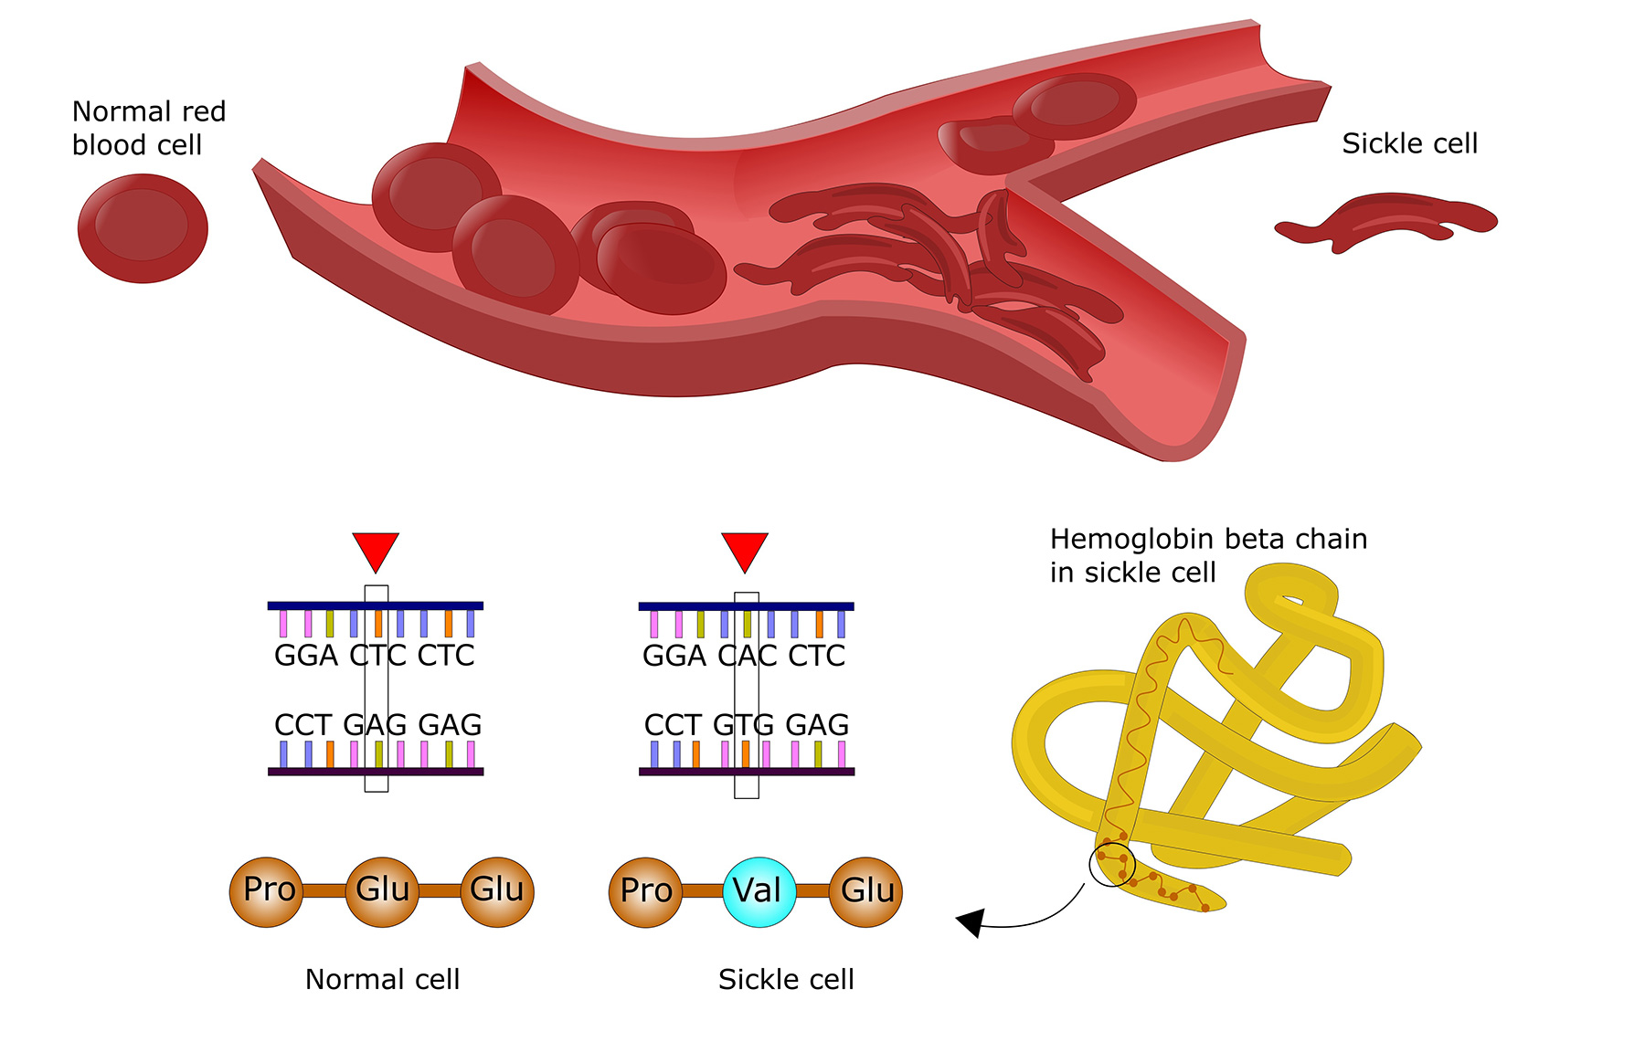
sickle cell anemia
mutation is called substitution

Slide 61
Signs and symptoms of sickle cell anemia vary between individuals. Some of the commonly noted symptoms include:
Anemia or decreased number of RBCs and oxygen
Irritability易怒 or fussiness暴躁 in babies
Severe fatigue or tiredness
Frequent episodes of pain疼痛, in different parts of the body
Swelling of hands and feet, associated with pain
Frequent infections
Delayed growth noted in children and adults
Vision problems

Slide 62
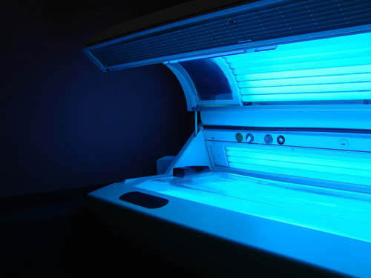
Mutagenic agents/mutagens
The natural spontaneous mutation rate is typically around one or two mutations per 100,000 genes per generation.
The mutation rate can be increased by mutagenic agents, which include UV radiation and harmful chemicals. These disrupt the structure of DNA or interfere with transcription.
Mutations provide the genetic variation needed for evolution, however they can produce harmful effects.
Notes:
Photo credit: © Shutterstock 2009, DrHitch

Slide 63
Cystic fibrosis囊性纤维化
Cystic fibrosis (CF) is a recessive inherited disease. It is caused by a number of different point mutations in the CFTR gene, which codes for a transmembrane protein that acts as an Cl- pump.
The CFTR gene is found on chromosome 7. It codes for 1480 amino acids. There are over 1000 known mutations, which can affect the function of the CFTR gene in different ways.
In around 70% of cases CF is caused by a triplet deletion, resulting in the removal of an amino acid from the polypeptide chain produced.

Slide 64
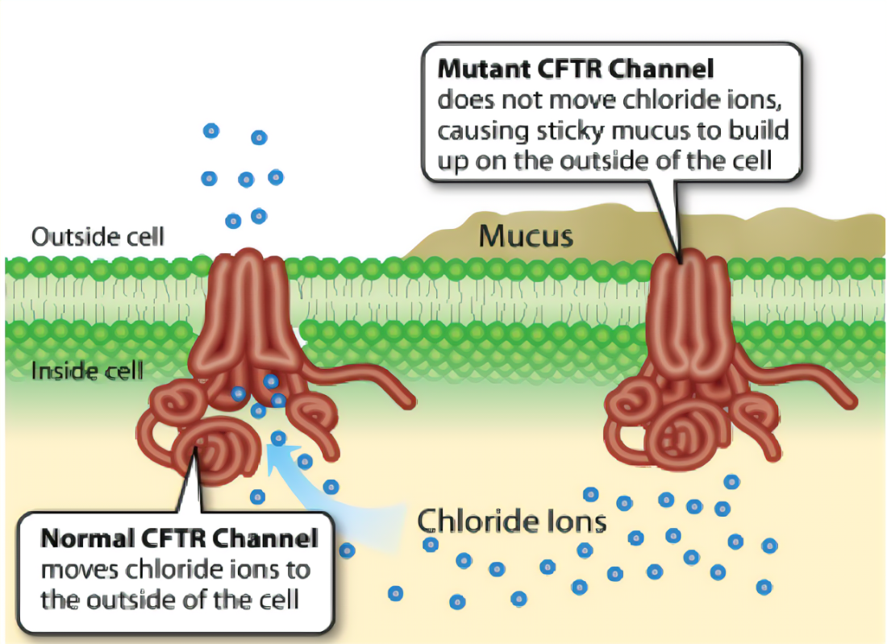
normally，In the lung,the CFTR ion channel moves chloride ions from inside the cell to outside the cell.
With CFTR mutations, excessive Cl- accumulate inside the cell, causing more water to return from the outside and mucus to be more thick and sticky
water moves in—thick mucus
water moves out—dilute mucus
Notes:
cftr运输cl离子是主动运输，消耗atp

Slide 65
Effects on respiratory system
unable to move as the mucus is so thick and sticky
frequent infections
block airways which limits gas exchange
The surface area for gas exchange is reduced which can cause breathing difficulties
lack in energy
reduced immunity

Slide 66
Effects on the digestive system
Thick mucus in the digestive system
Blockage of the pancreatic duct reduces digestion of nutrients
The villi of the small intestine are covered to reduce absorption
malnutrition
Islets胰岛 may be destroyed by enzymes, leading to disease-diabetes
Notes:
胰腺分为外分泌部和内分泌部两部分。外分泌腺由腺泡和腺管组成，腺泡分泌胰液，腺管是胰液排出的通道。胰液中含有碳酸氢钠、胰蛋白酶原、脂肪酶、淀粉酶等。胰液通过胰腺管排入十二指肠，有消化蛋白质、脂肪和糖的作用。
内分泌腺由大小不同的细胞团——胰岛所组成，胰岛主要由4种细胞组成：α细胞、β细胞、D细胞、PP细胞。
α细胞分泌胰高血糖素，升高血糖；
β细胞分泌胰岛素，降低血糖；
D细胞分泌生长抑素，以旁分泌的方式抑制A、B细胞的分泌；
PP细胞分泌胰多肽，抑制胃肠运动、胰液分泌和胆囊收缩。

Slide 67
Effects on the reproductive system
in men，seminiferous duct is blocked, preventing sperm from reaching the penis
In women thickened cervical mucus can prevent sperm reaching the oviduct to fertilise an egg

Slide 68
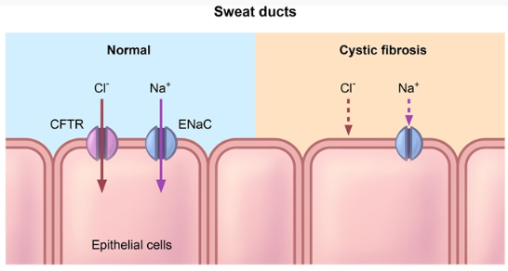
Effects on the sweat glands
In sweat glands, CFTR functions to reabsorb Na+，Cl-
Sweat is mainly composed of salt and water
Reabsorption of salt prevents the body from losing too much salt
Mutations in CFTR cause sodium and chloride ions remain in sweat
Saltier sweat
Notes:
Epithelial Sodium Channel

Slide 69
There are three main uses of genetic screening
ldentifying carrier: individuals who carry an allele at a gene locus for a particular disorder
The screening of embryos prior to implantation during fertility treatment; this is Preimplantation Genetic Diagnosis (PGD)-试管婴儿
Testing a foetus before birth; this is prenatal testing产前诊断
Notes:
第三代试管婴儿的技术也称胚胎植入前遗传学诊断/筛查 [1] （PGD/PGS） [1] ，指在IVF-ET的胚胎移植前，取胚胎的遗传物质进行分析，诊断是否有异常，筛选健康胚胎移植，防止遗传病传递的方法。
检测物质取4～8个细胞期胚胎的1个细胞或受精前后的卵第一二极体。取样不影响胚胎发育。检测用单细胞DNA分析法，一是聚合酶链反应（PCR），检测男女性别和单基因遗传病;另一种是荧光原位杂交（FISH），检测性别和染色体病。第三代试管婴儿技术可以进行性别选择，但只有当子代性染色体有可能发生异常并带来严重后果时，才允许进行性别选择。本质上，第三代试管婴儿技术选择的是疾病，而不是性别。
CVS:绒毛取样可以经阴道，也可以经腹进行。经阴道取样法：受检妇女平卧，双膝屈曲，用足蹬或膝蹬支撑；在超声扫描引导下，医生将导管（一种易弯曲的细管）经阴道、子宫颈送入胎盘绒毛部分，用空针管吸取少量绒毛送检。有子宫颈病变，生殖道感染，如生殖道疱疹、淋病、慢性宫颈炎等，不宜经阴道取样。
经腹取样法：腹部皮肤局麻，穿刺针经腹壁进入胎盘绒毛部分，用空针管吸取少量绒毛送检。

Slide 70
Identification of carriers
Cell samples can be extracted from, e.g. blood or saliva
determine the probability of future children inheriting the disorder
●Some of the benefts include
Families can make informed decisions before having children
Women can decide whether to have prenatal testing during pregnancy

Slide 71
PGD
Hormone treatment stimulates Graafian follicles to develop in the ovary at the same time.
mature oocytes are removed by a syringe.
Sample of semen is extracted
Sperm and oocytes are mixed in suitable solution. Fertilisation occurs.
Zygotes divide in culture solution to produce embryos.
Two or three early embryos are inserted into uterus
Remaining embryos frozen and stored for later use.
Notes:
This is the stage at which a cell is removed from the embryos for preimplantation genetic diagnosis.
试管婴儿：一个胚胎细胞用来诊断，活检，无误后植入体内，剩下的冷冻
一般情况 下，做第三代试管婴儿会放置1~2枚的胚胎，具体的数量需要根据患者的年龄、身体情况来决定。如果不孕不育的女性超过了35岁，或者第二次以上的移植，可以放置3枚胚胎。并且，胚胎培养到囊胚状态也经过染色体筛查，还能够预防一些遗传病的出现。但是试管不能保证一次就过，所以调理好身体有更多优质的卵子和胚胎，才是提高成功率的关键方法。

Slide 72
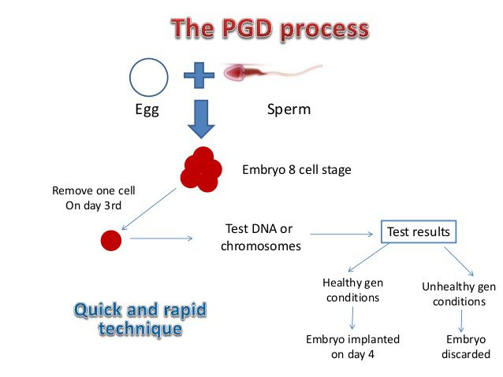

Slide 73
Benefts of PGD include
does not harm the embryo in any way
Reduces the chances of having a baby with a genetic disorder
It avoids abortion as it is carried out before implantation of the embryo
■ It is worth noting that some people believe that an embryo is as worthy of human status as a foetus or a baby, so the discarding of affected embryos after PGD is not ethically straightforward for everyone

Slide 74
Prenatal testing
The DNA can be obtained by chorionic villus sampling or amniocentesis in the uterus
Amniocentesis involves removing about 20cm3 of the amniotic fuid which surrounds the fetus using a needle and syringe.
This is done at about the 16th week of pregnancy.
Fetal epithelial cells and blood cells can be recovered from the fuid after spinning it in a centrifuge.
The cells are cultured for 2---3 weeks and then a number of genetic defects and the sex can be determined .

Slide 75
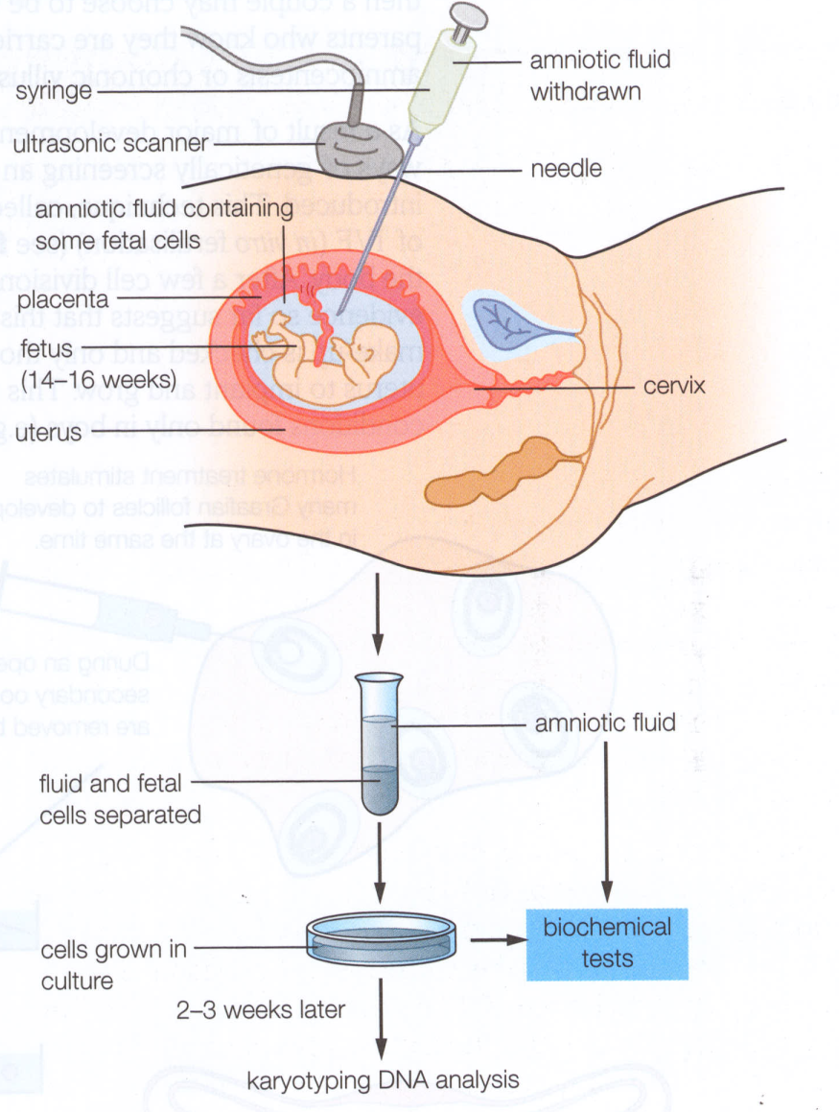

Slide 76
Amniocentesis has the following disadvantages.
It can only be carried out relatively late in the pregnancy making it very difficult for the parents if termination of the pregnancy is necessary.
The results are not available until 2-3 weeks after the test.
It carries a 0.5- -1% risk of spontaneous abortion after the procedure, regardless of the genetic status of the fetus

Slide 77
In chorionic villus sampling, a small sample of embryonic tissue is taken from the developing placenta at 8-10th week.
Insert an instrument called a speculum窥镜 into your vagina
Using ultrasound guidance, a thin tube will be guided through the cervix to the chorionic villi.
3. Ultrasound will be used to help guide a long, thin, hollow needle through your abdomen and into the uterus and placenta.
4. Cells will be gently suctioned through the tube into a syringe.
5. The tube/needle will then be removed.
Notes:
There are two types of CVS procedures:
Transcervical. In this procedure, a catheter is inserted through the cervix into the placenta to obtain the tissue sample
Transabdominal. In this procedure, a needle is inserted through the abdomen and uterus into the placenta to obtain the tissue sample

Slide 78
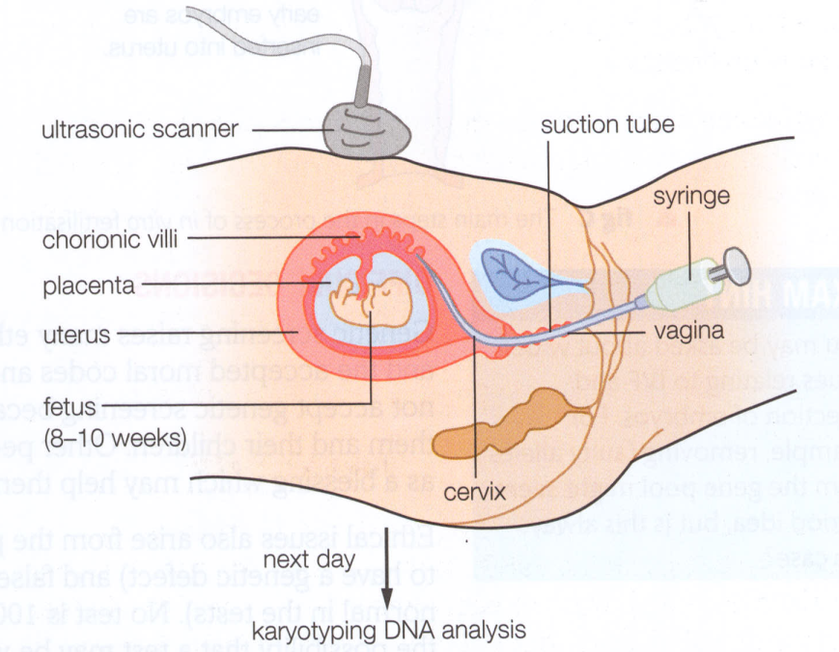
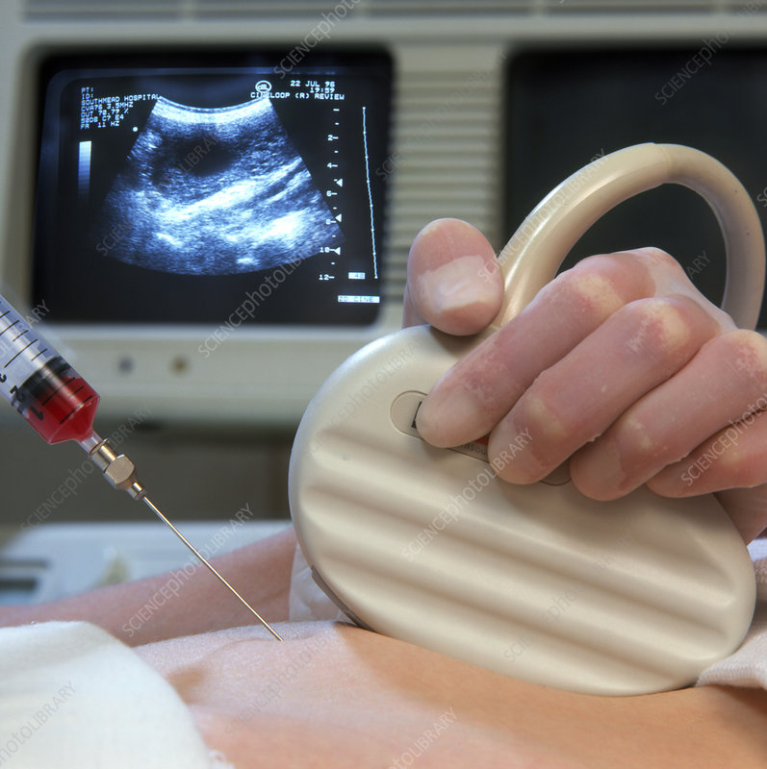

Slide 79
benefits of CVS：
This makes a much bigger sample of fetal tissue available for examination.
The cells can be tested for a wide range of genetic abnormalities.
This diagnostic technique can be carried out much earlier in the pregnancy, so that if a termination is necessary it is physically less traumatic for the mother
The results are also available more rapidly than for amniocentesis.

Slide 80
There are two disadvantages to chorionic villus sampling.
● There is a 0.5- -1% risk that the embryo may spontaneously abort after the tissue sample is taken
● All paternal X chromosomes are inactivated in fetal placental cells so any problems in the genes on that chromosome cannot be detected by this technique.
Notes:
剂量补偿效应，英文名是 dosage compensation 。使细胞核中具有两份或两份以上基因的个体和只有一份基因的个体出现相同表型的遗传效应。一个细胞核中某一基因的数目称为基因剂量。在以性染色体决定性别的动物中，常染色体上的基因剂量并无差别，因为雌雄两性动物的常染色体的形态和数目都相同。但是对于性染色体来讲，包括人类在内的哺乳动物雌性个体的每一体细胞中有两条X染色体，所以在X染色体上的基因剂量有两份，而雄性个体只有一条 X染色体，基因剂量只有一份。
①正常雌性哺乳动物体细胞中的两个，X染色体之一在遗传性状表达上是失活的；
②在同一个体的不同细胞中，失活的X染色体可来源于雌性亲本，也可来源于雄性亲本；
③失活现象发生在胚胎发育的早期，一旦出现则从这一细胞分裂增殖而成的体细胞克隆中失活的都是同一来源的染色体。
人类女性的X染色体失活在胚胎发育的第16天就已发生，而且哪一条X染色体失活是随机的。其他有胎盘的哺乳动物也类同,但有袋类（如雌性袋鼠）失活的X染色体是有选择性的，失活的总是来源于雄性亲本的X染色体。
但很多疾病临床表型多变，X染色体失活只是有可能导致表型差异的其中一个因素。研究显示，人类中有15%的X-连锁基因会出现XCI逃逸，可能是因为它们编码的是一些高度剂量敏感的关键蛋白。逃逸基因的表达程度不同也可能会导致临床表型的差异。
Imprinted X Inactivation: Preferential Silencing of the Father
As mentioned earlier in the article, there are two types of X inactivation: imprinted and random. During imprinted X inactivation, the paternal (father's) X chromosome is preferentially silenced in the placenta (an extraembryonic tissue) of eutherian mammals, as well as in all cells of earlier marsupial mammals, such as opossums and kangaroos (Graves, 2006; Huynh & Lee, 2005). Interestingly, XIST and TSIX are both important for imprinted XCI in the mouse (a eutherian), but marsupials do not have an XIST gene homologue (Duret et al., 2006; Lee, 2000; Marahrens et al., 1997; Sado et al., 2001). This raises the question of how imprinted inactivation is achieved in marsupials without using XIST. One possible mechanism involves pre-silencing of the paternal X in the male germ line during a process whereby both sex chromosomes are inactivated during meiosis; here, the inactive state of the X could be transmitted to the next generation (Hornecker et al., 2007; Huynh & Lee, 2005; Namekawa et al., 2007). From an evolutionary point of view, such a form of inherited XCI would have easily and economically achieved dosage compensation in female embryos, because only females inherit an X chromosome from their fathers.
Interestingly, remnants of this type of mechanism may still exist in eutherian mammals, such as the mouse (Huynh & Lee, 2005). While debate remains concerning the details of how and when dosage compensation is achieved, it is clear that imprinted XCI first occurs in all cells of early eutherian mammalian embryos prior to implantation into the uterus (Huynh & Lee, 2005; Okamoto & Heard, 2006). Together with the fact that earlier mammals, such as marsupials, also only silence their paternal Xs, imprinted XCI may represent an evolutionarily ancestral form of X inactivation. Occurring before the appearance of XIST and TSIX, imprinted XCI led to the evolution of random XCI in eutherian mammals.
Random X Inactivation
Random X inactivation occurs in the early female embryo, where both the maternal and the paternal X chromosome have an equal chance of becoming inactivated (Figure 4). Each female cell has the difficult task of trying to distinguish between two X chromosomes within the same nucleus, then designating one as an active X chromosome and the other as an inactive X. This complex process of silencing is accomplished independently in each cell, largely by XIST and TSIX.
Embryonic stem (ES) cells can undergo random X inactivation when differentiated in vitro (Martin et al., 1978; Rastan & Robertson, 1985), and they thus serve as a good model system with which to study this phenomenon. In fact, the use of ES cells along with early mouse embryos has enabled geneticists to dissect the different phases of the random XCI pathway. It seems that each cell first counts its number of X chromosomes, then randomly chooses one X to remain active, and, finally, silences the future inactive X (Bourmil & Lee, 2001). Whole-chromosome silencing involves the recruitment of many specialized factors, such as histone variants and chromatin modifiers (Lucchesi et al., 2005).
In addition to silencing one of the two Xs, the cell must also make sure that the other X remains active. Thus, there must be a way for the two Xs to communicate with each other to designate mutually exclusive fates. Interestingly, recent evidence suggests that this communication is mediated by protein- and transcription-dependent pairing between the Xs during early development (Bacher et al., 2006; Xu et al., 2006, 2007). The random XCI story becomes even more complex with the discovery of various enhancers and modifiers that can alter or skew inactivation of one X chromosome over the other.

Slide 81
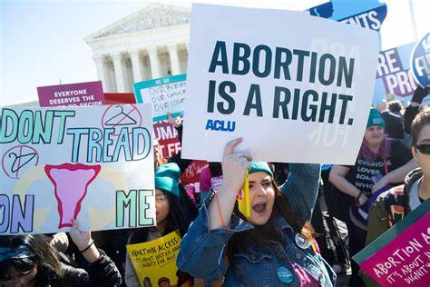
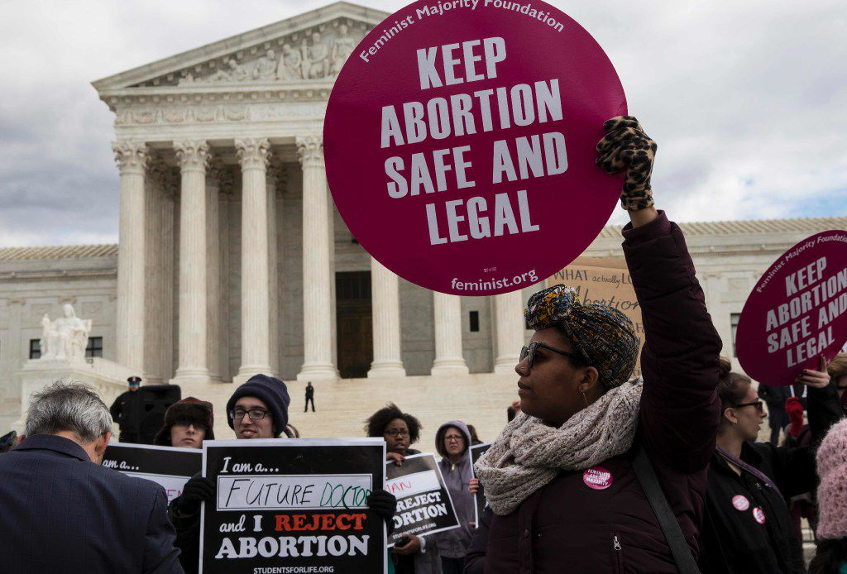
Ethical &Social Issuesof Genetic Screening
dependingon someone's religious, moral,andsocial position
Belief that God is in control may mean that a pregnancy will be continued no matter what genetic screening might show
belief that embryos are potential human beings would mean that the abortion of a foetus would be considered impossible

Slide 82
Processes that involve screening embryos on the basis of factors, e.g. sex or intelligence; the potential future of ' designer babies'
Positive screening results for non life-threatening conditions, e.g. Down syndrome,can lead to the abortion of foetuses
some believe the embryo or unborn baby that they are deserving of full human rights while others do not

Slide 84
Notes:
Teacher notes
In ‘Slide Show’ mode, click the name of a section to jump straight to that slide.

Slide 85
Glossary

Slide 86
What’s the keyword?

Slide 87
Multiple-choice quiz

